Slide 1
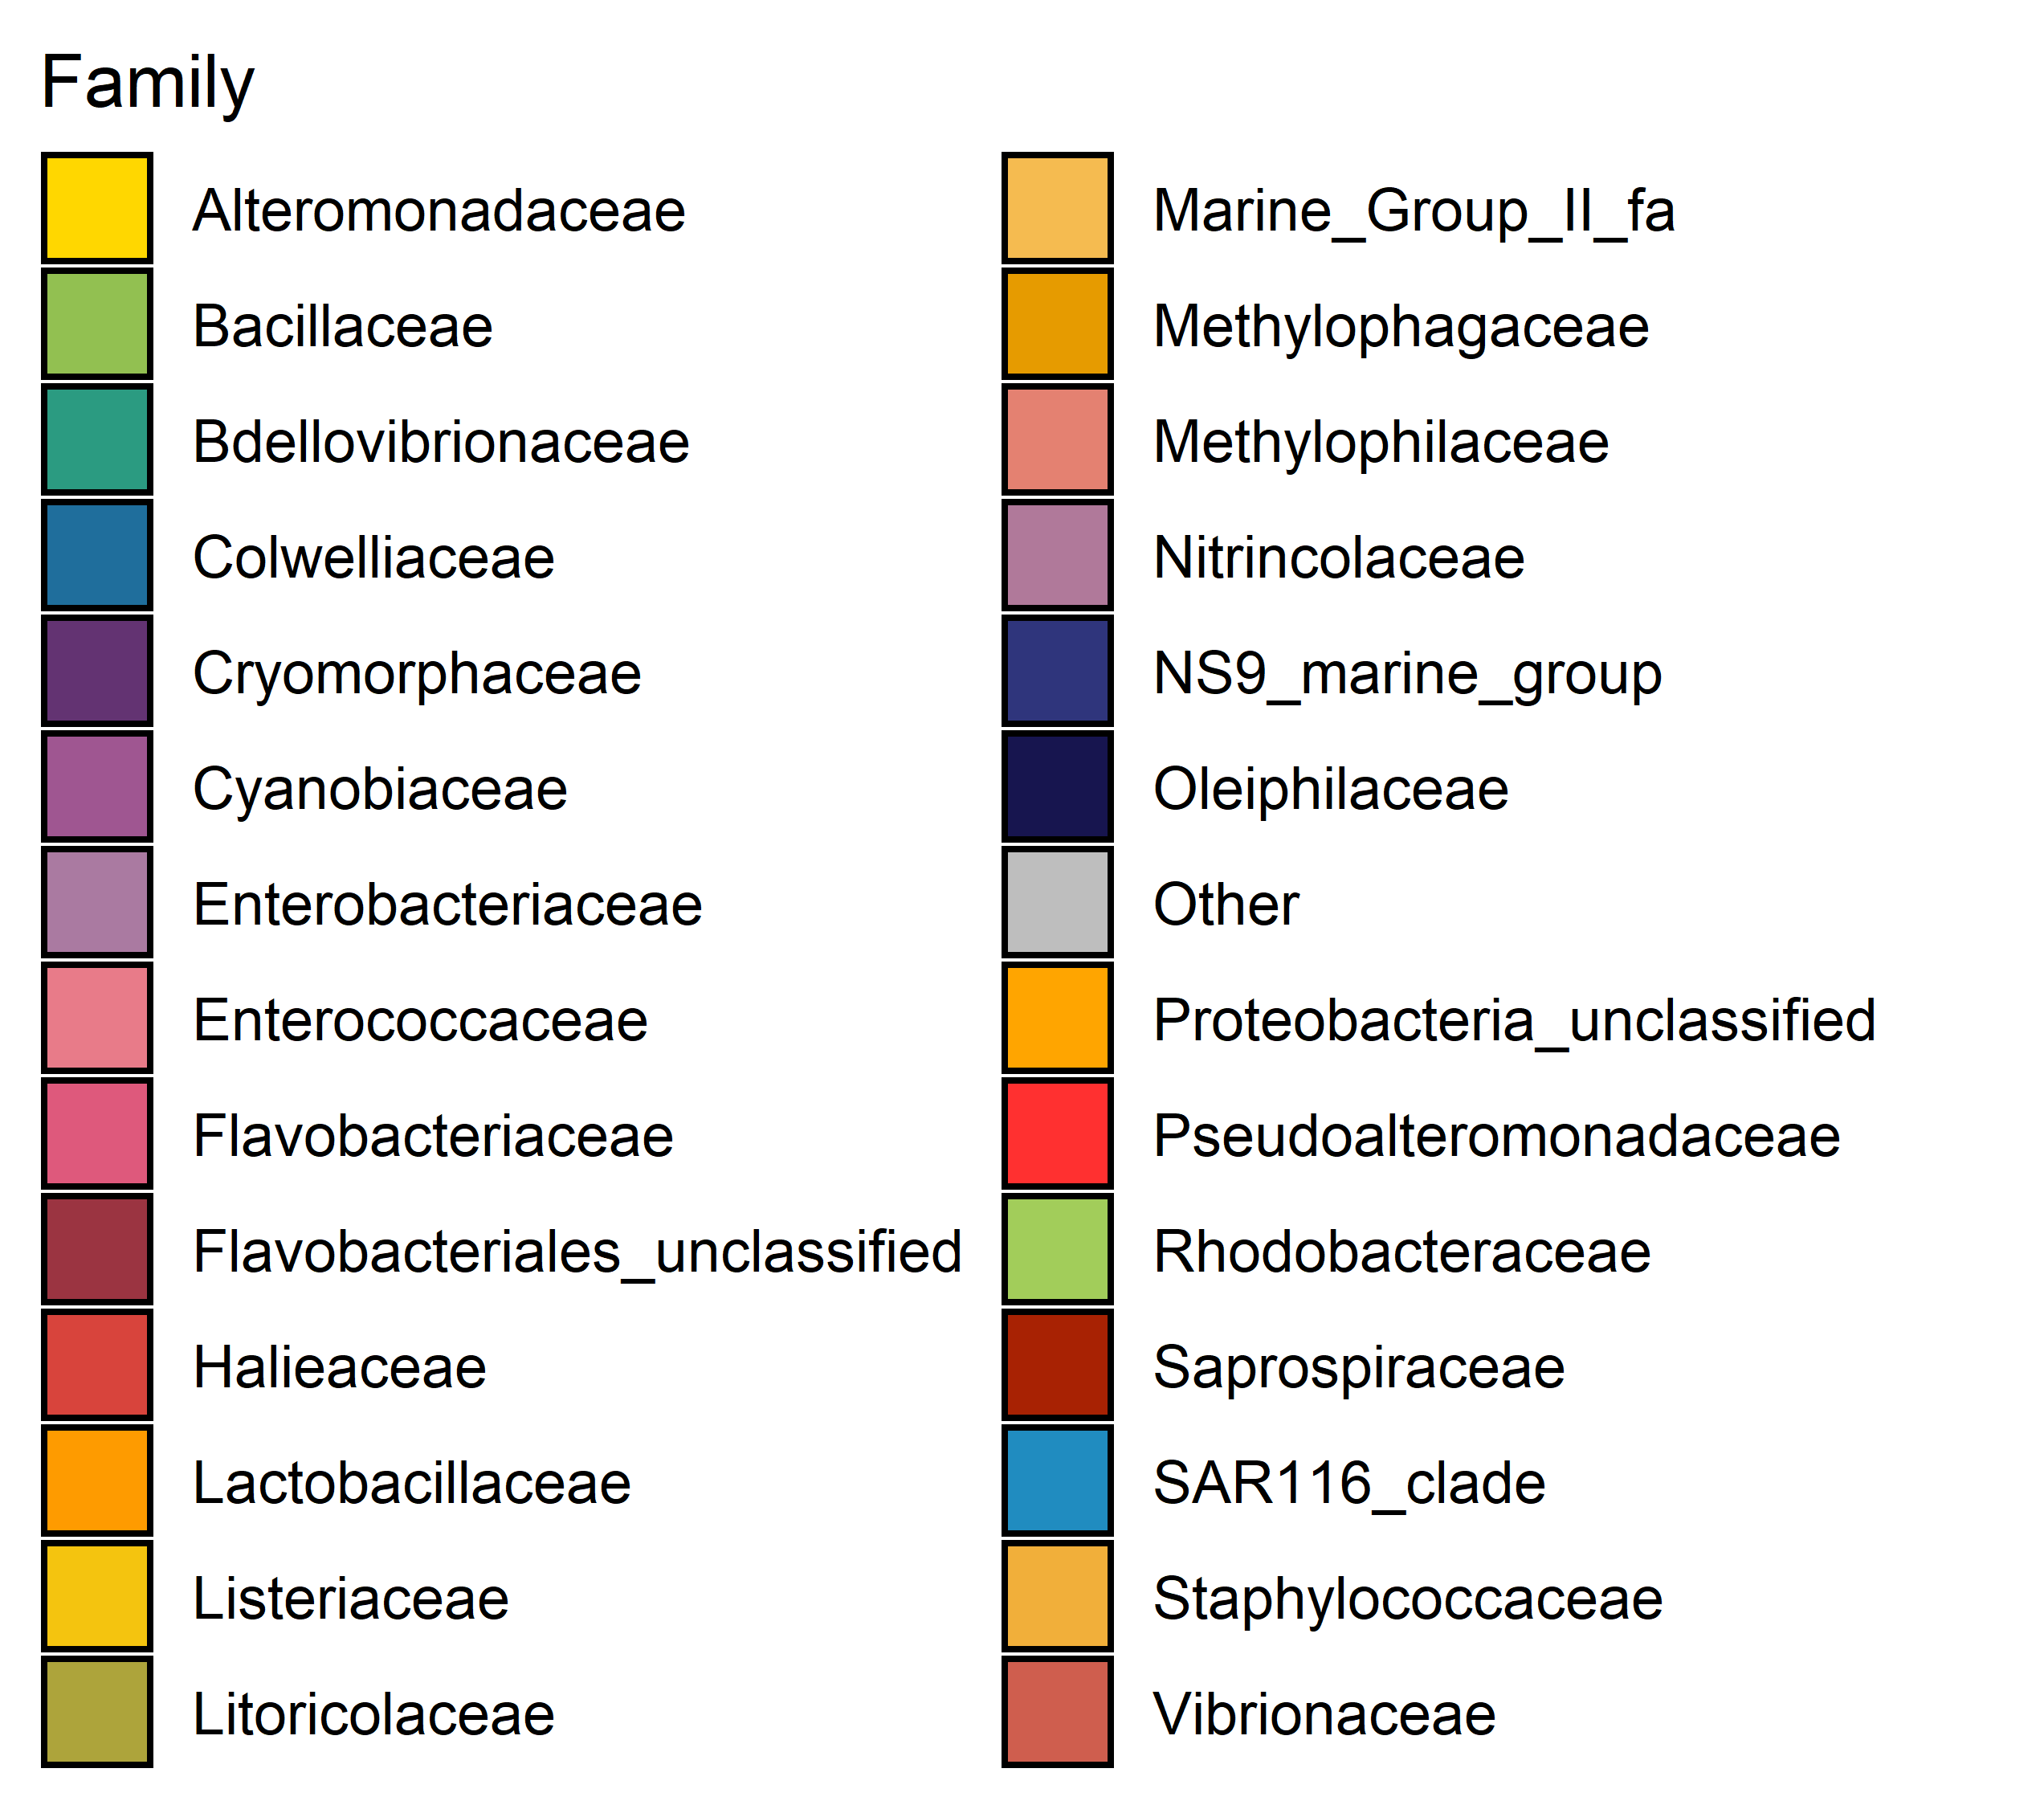
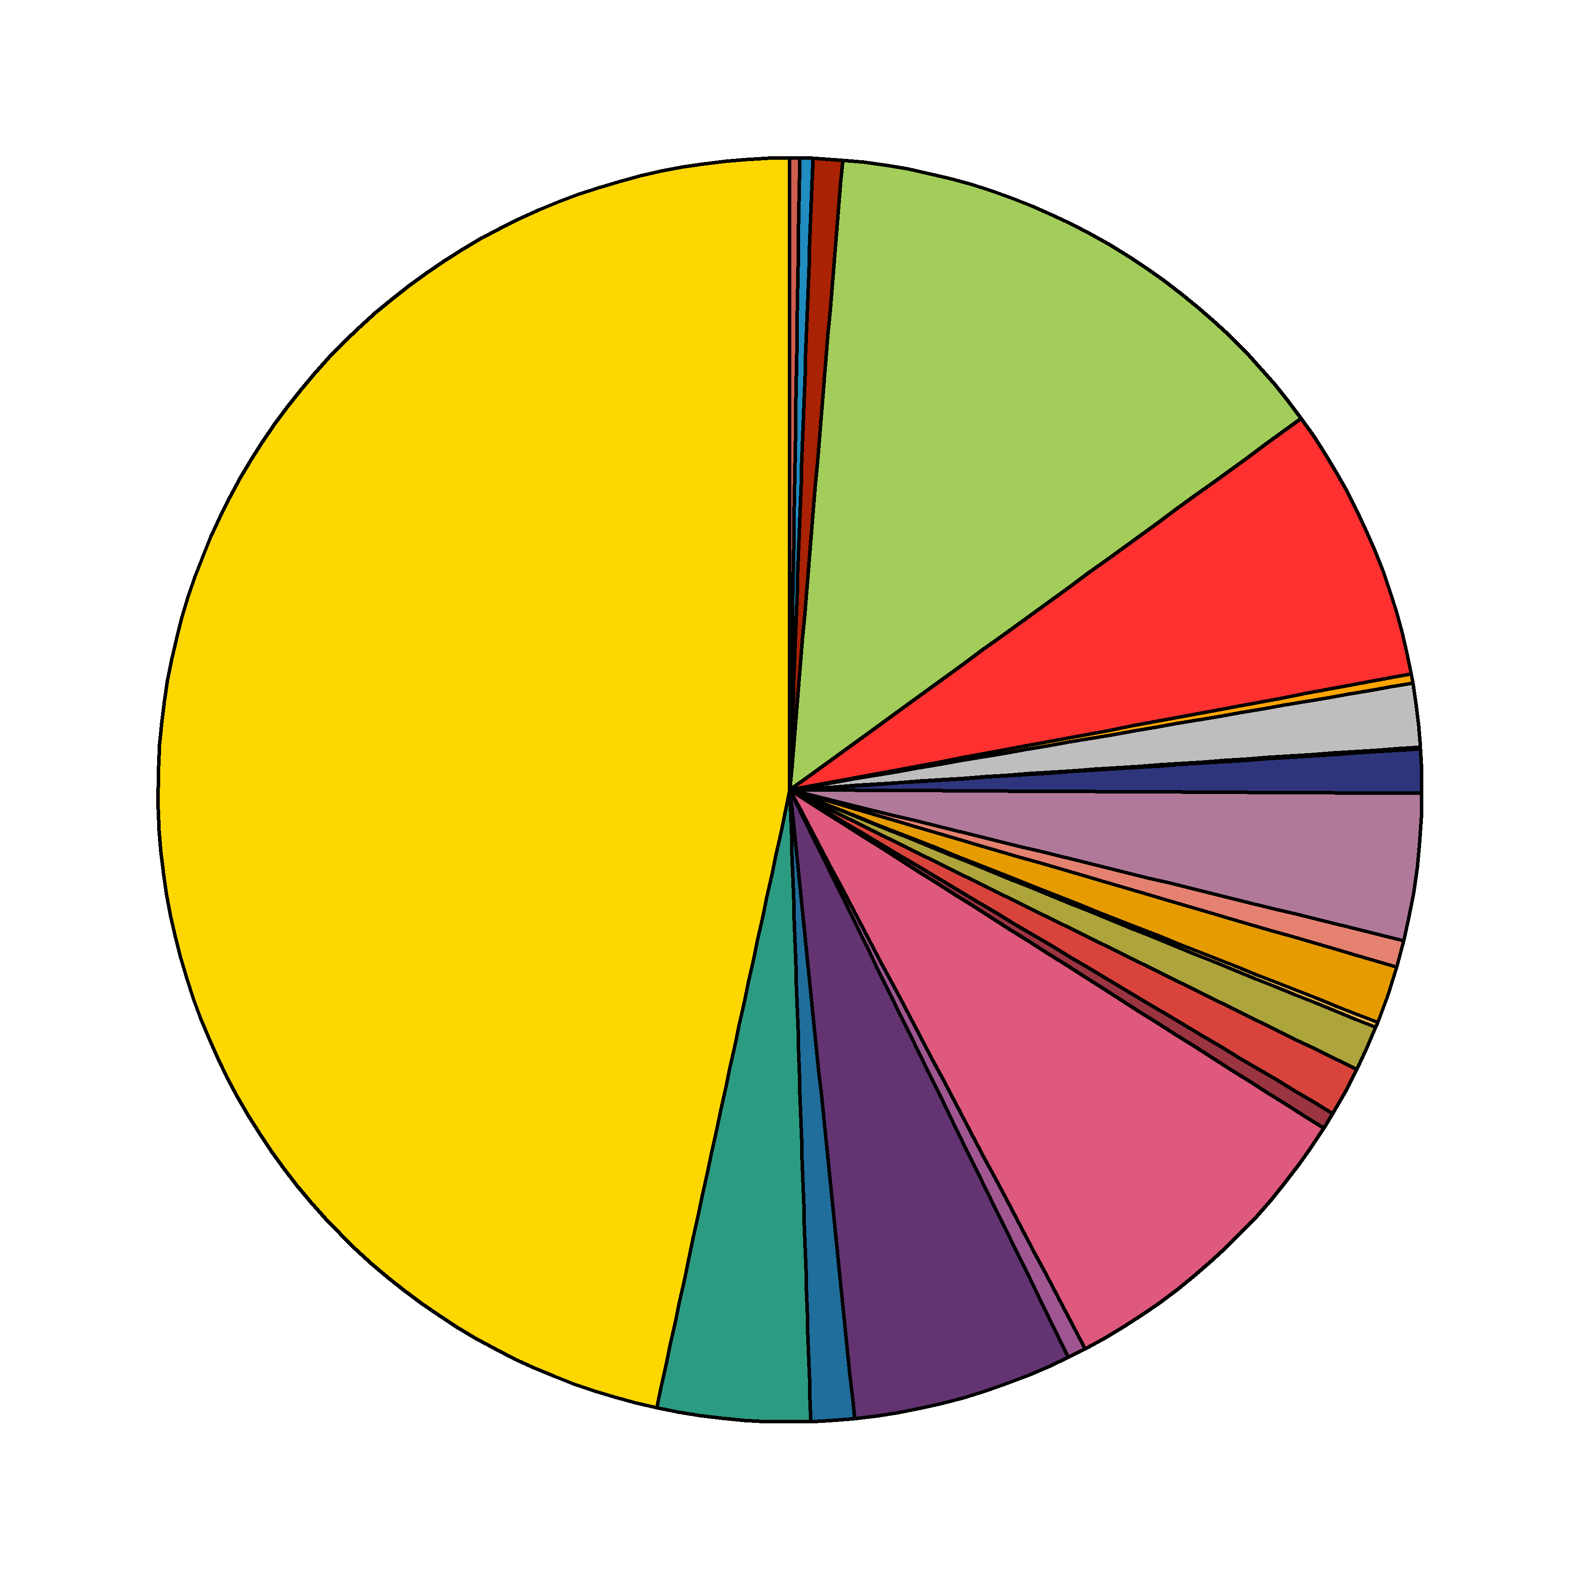
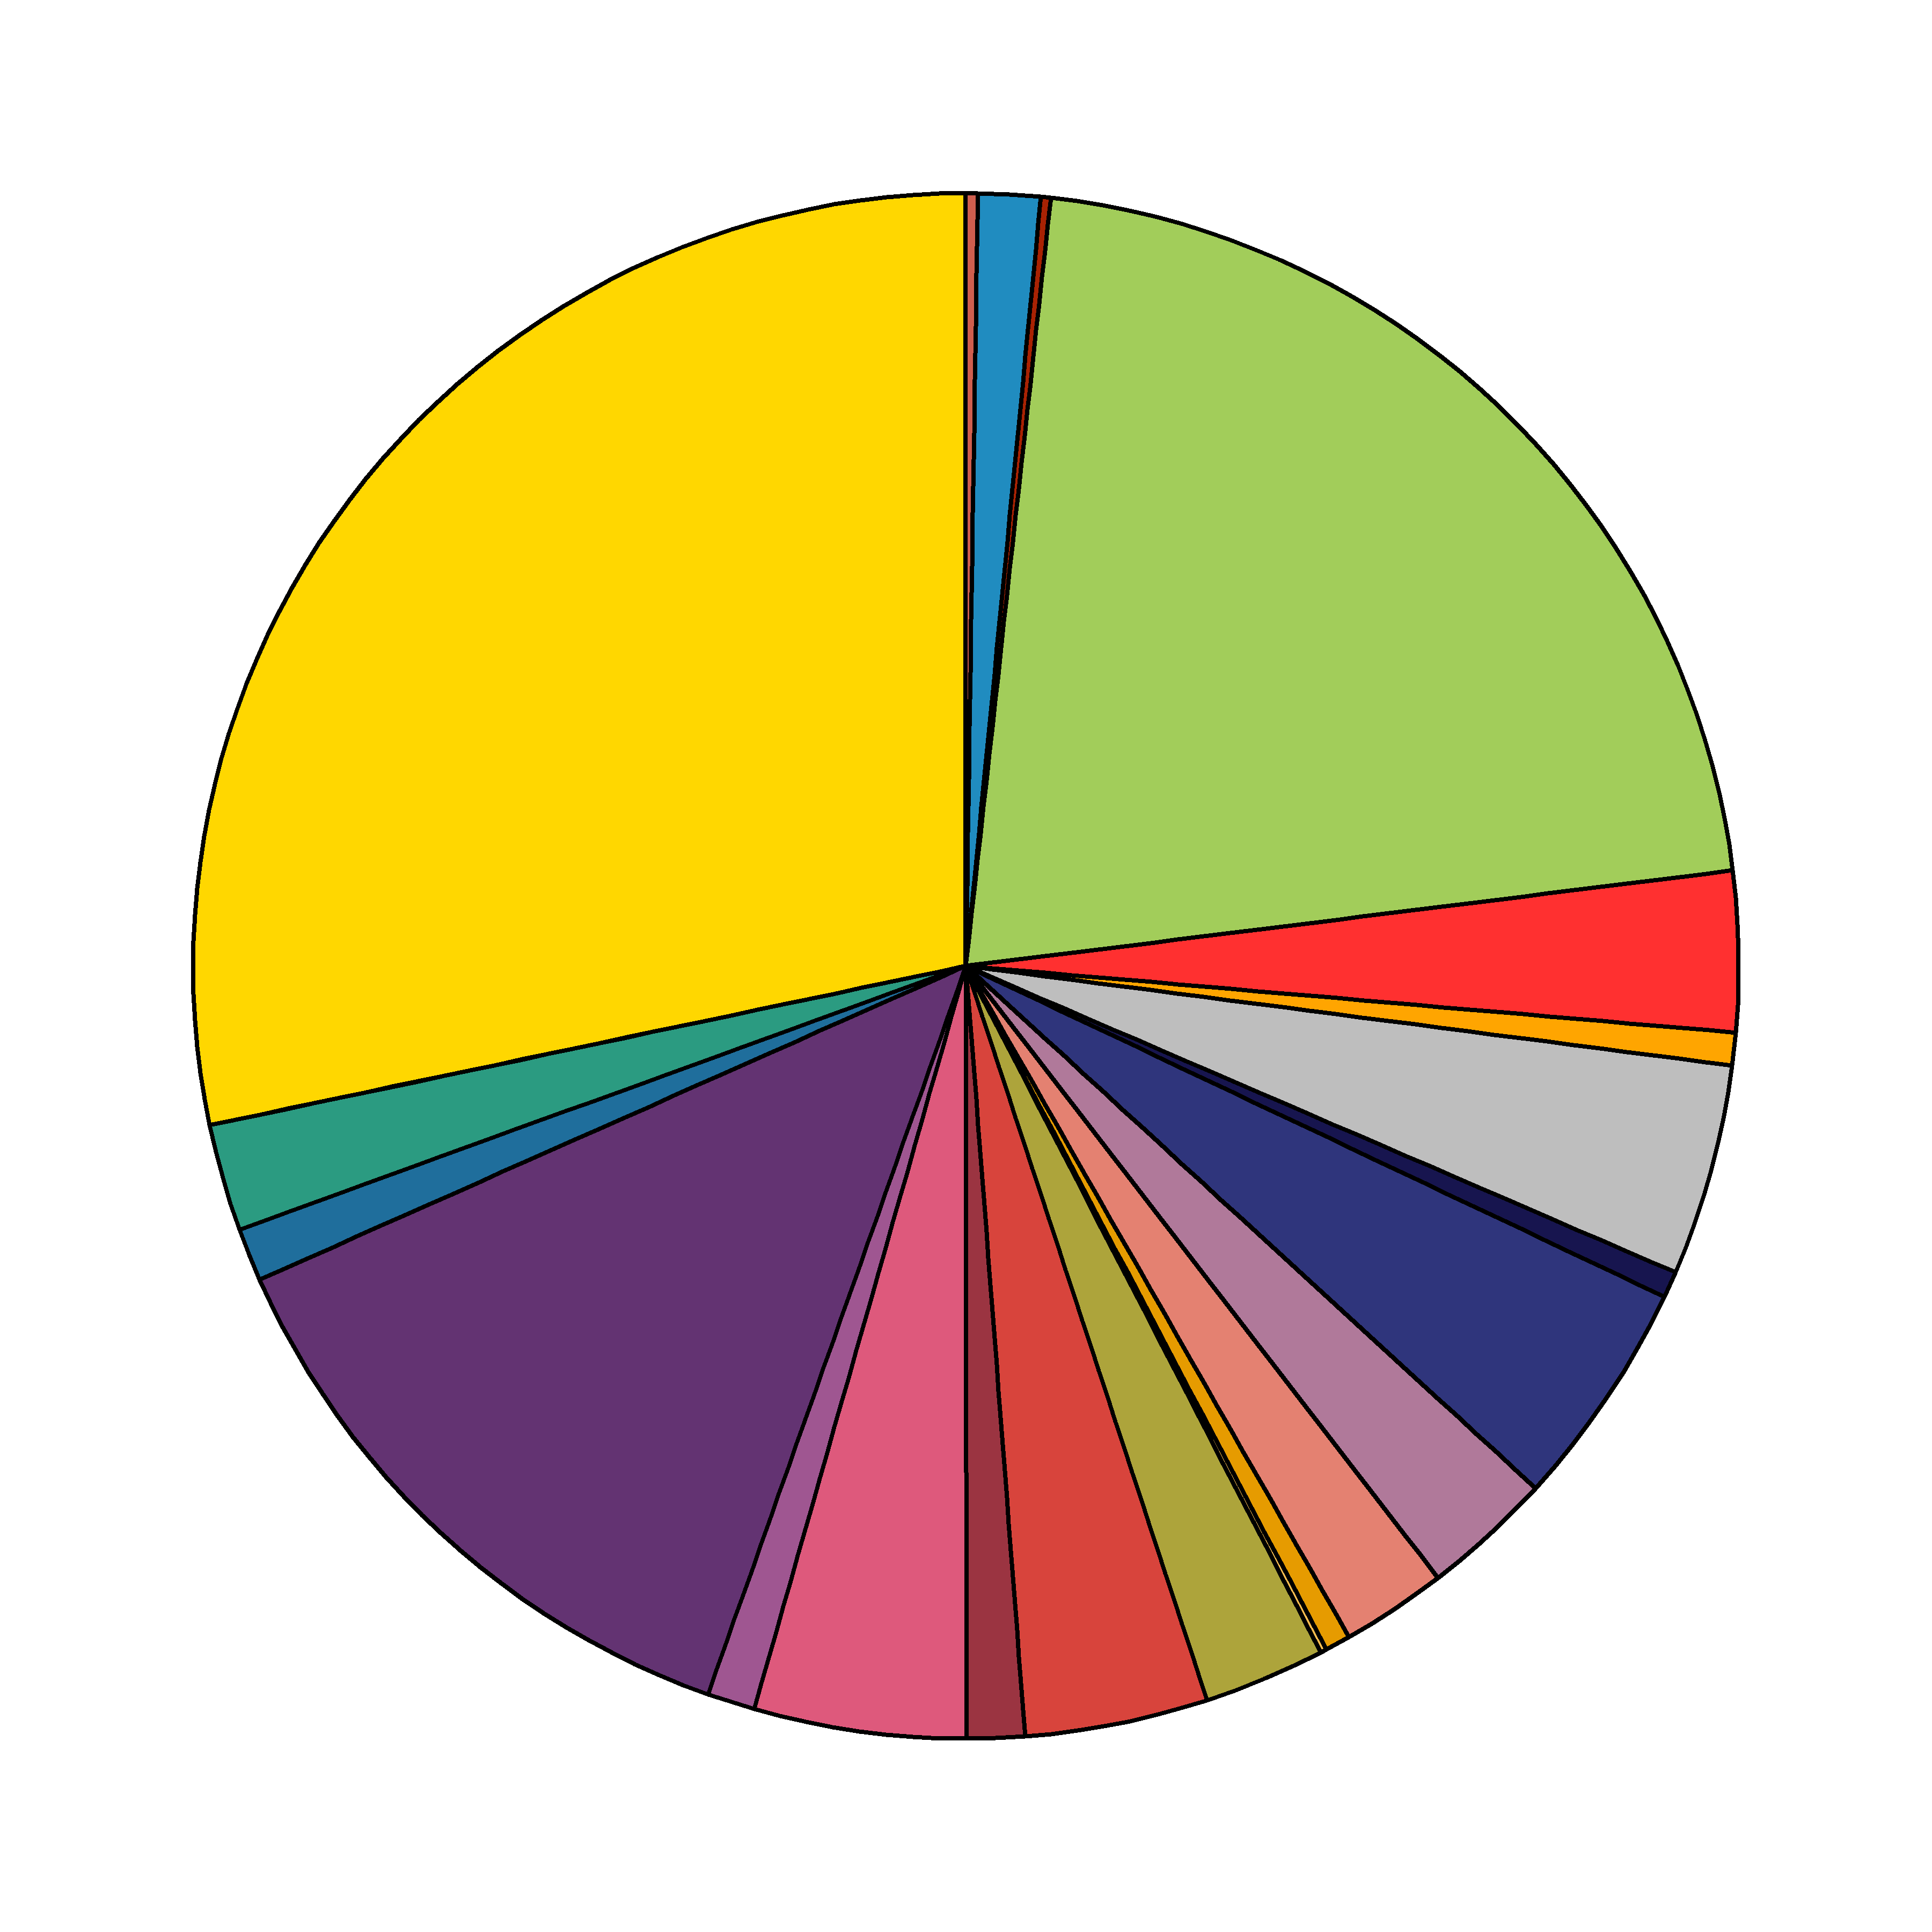
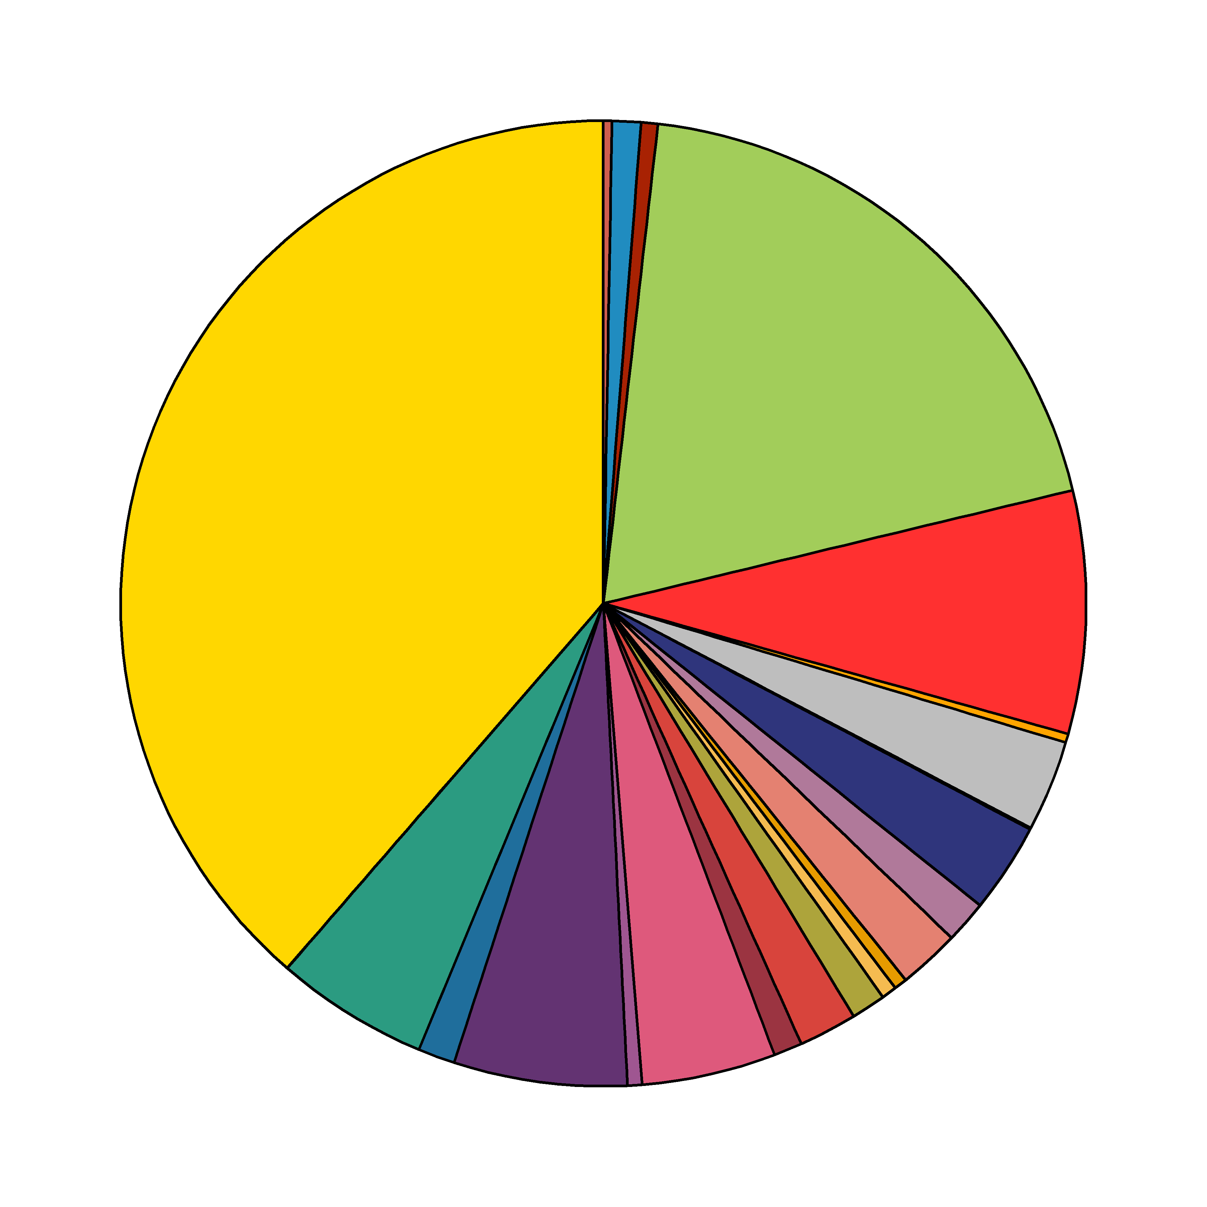
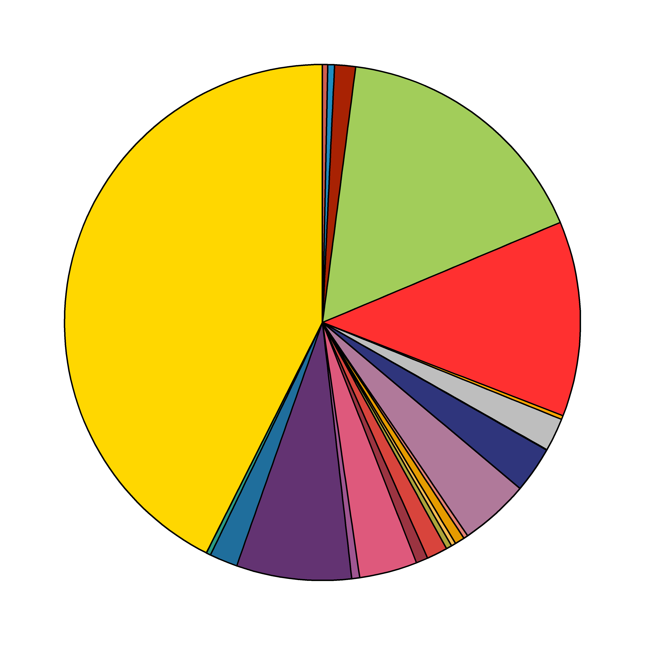
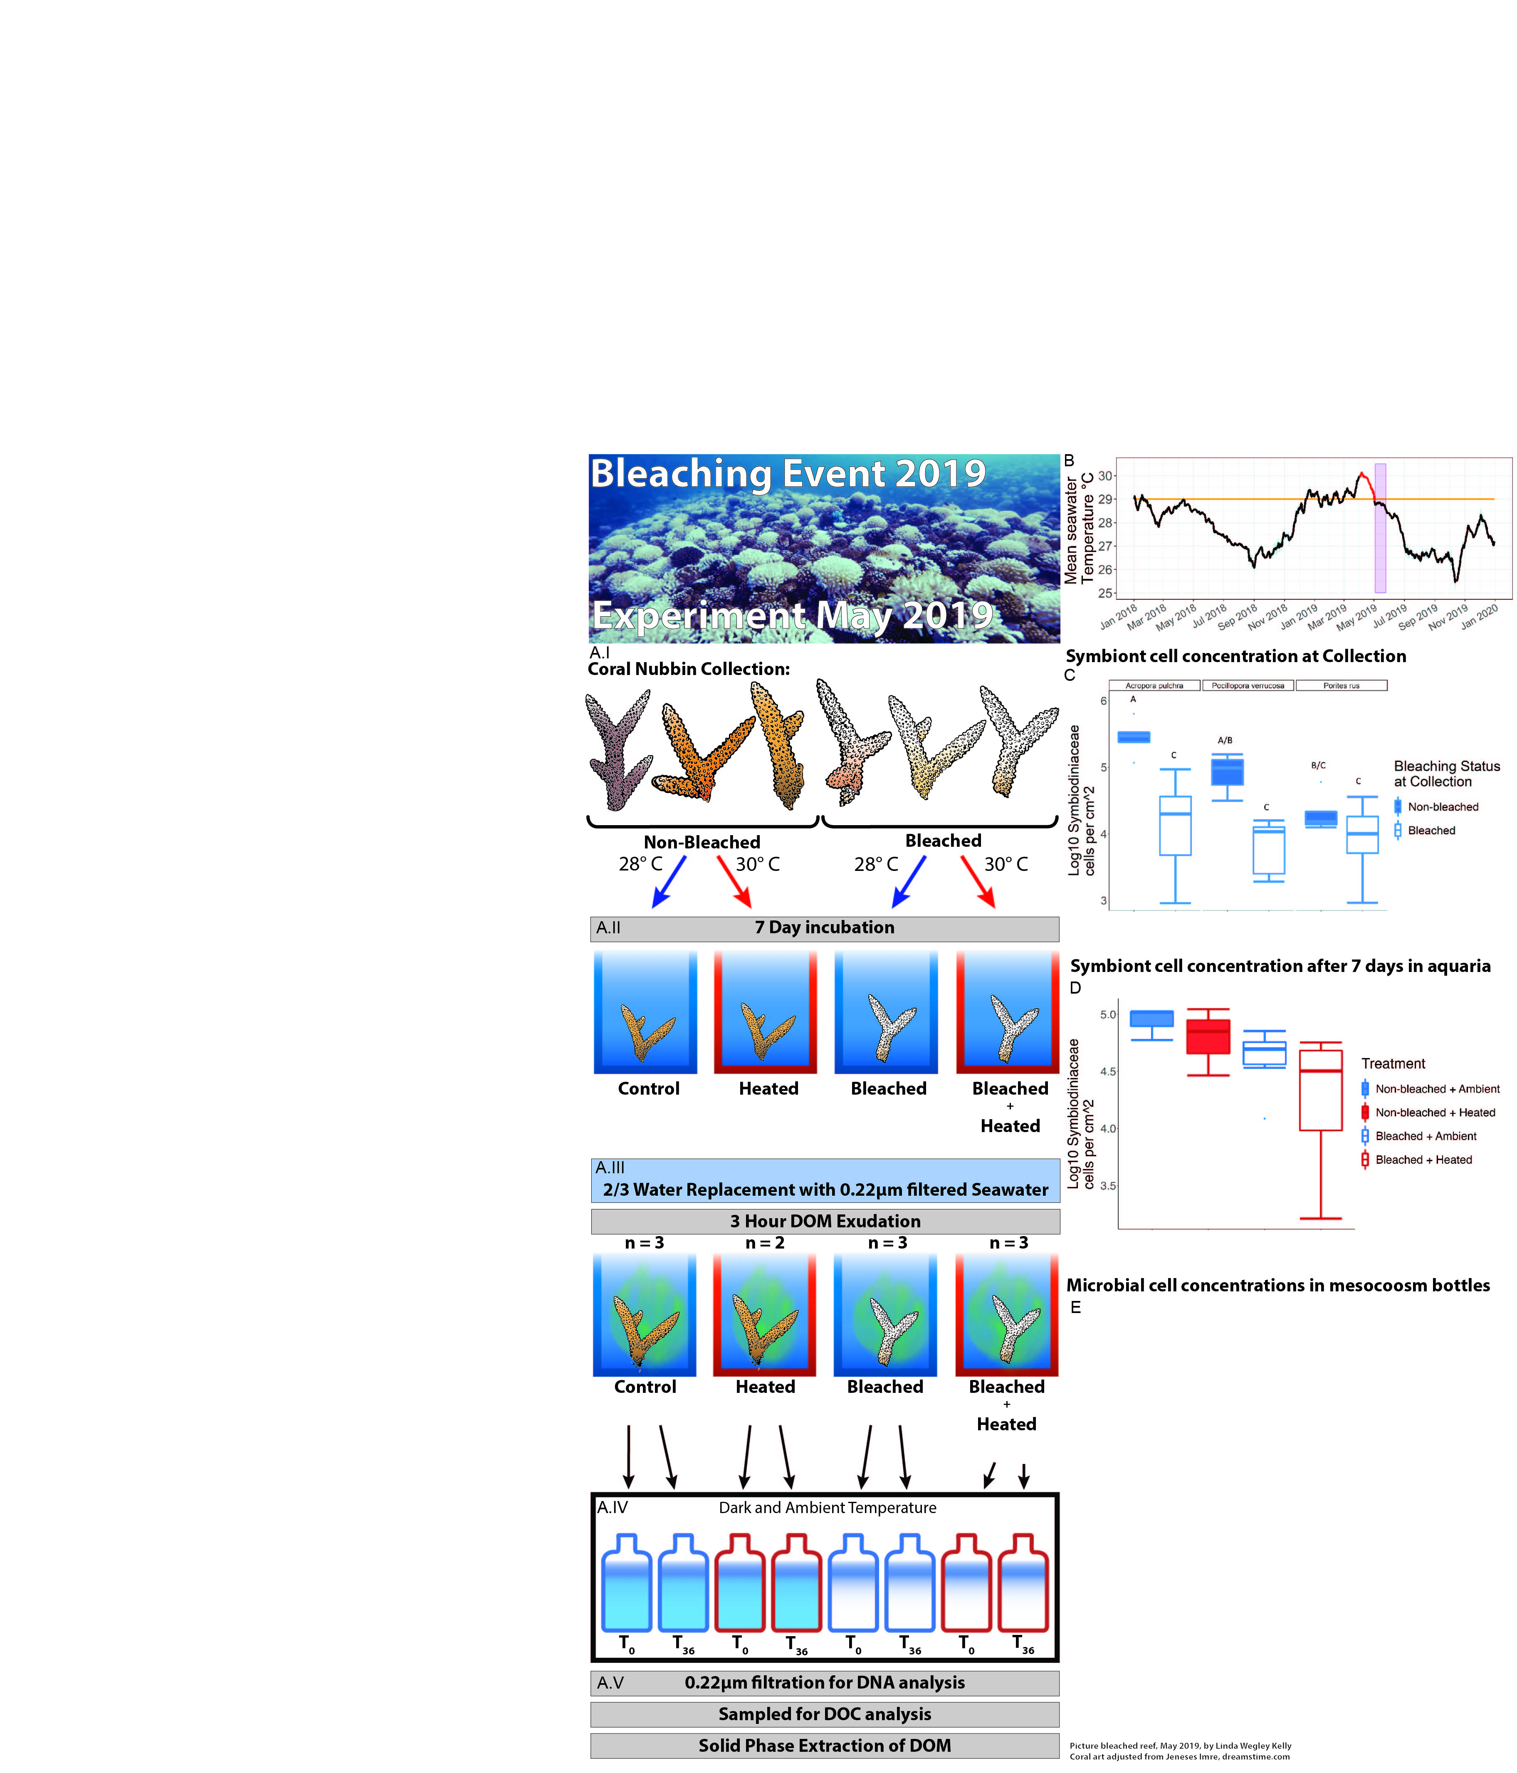
Microbialized bacterioplankton
Healthy bacterioplankton
Microbialized bacterioplankton
Microbialized bacterioplankton
DOM
Hypoxia, disease
DOM
Hypoxia, disease
DOM
Hypoxia, disease
DOM
“Healthy”
“Thermal Stress Onset”
“Peak Bleaching”
“Recovering”
“Ecosystem State”
Treatment
Non-bleached + Ambient
Non-bleached + Heated
Bleached + Heated
Bleached + Ambient
Temperature
Time

